Slide 1

Elections 101
Caroline Webster Geppert
Christina Worrell Adkins

Slide 2
What to Expect?
Basic Election Concepts
Terminology and “Election Lingo”
Citations and References
Preview of other Presentations

Slide 3
Election Glossary/Acronym List

Slide 4
Sources of Law
Texas Constitution
Texas Election Code
Texas Administrative Code
Advisories/Memos
OAG Opinions
Other Texas Statutes
  Local Government Code
  Government Code
  Education Code
  Water Code,
  Agriculture Code, etc…..

Slide 5
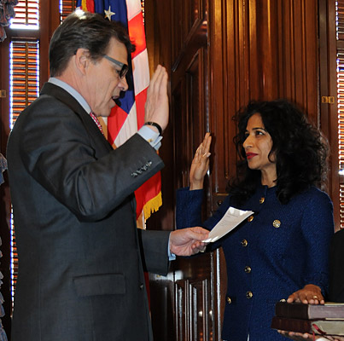
Secretary of State
Secretary Nandita Berry
  Chief Election Officer
  Official Forms
  Uniformity
  Assistance and Advice
  Voting Rights Hotline
  Referral of Complaints to OAG

Slide 6
County Election Officials
County Election Commission
  County judge, county clerk, county tax assessor-collector, county chair of each political party.
County Election Board
  County judge, county clerk, VR, sheriff
  County chair of each political party required to nominate by primary election

Slide 7
Election Officials
County Clerk
Tax-Assessor Collector as Voter Registrar
County Elections Administrator

Slide 8
Election Officials
Local Election Officials
  Custodian of Election Records.
  Early Voting Clerk.
  Procuring, Ordering and Delivering Supplies.
  Preparing Ballots.
  Maintaining Office Hours before and after election.
  Receiving Candidate Applications.
  Preparing and Delivering certain reports to SOS.

Slide 9
Election Officials
Early Voting Clerk
Presiding Judge/Alternate Judge
Election Day Clerks
Early Voting Ballot Board

Slide 10
Party Officials
County Executive Committee
Precinct Executive Committee
Primary Committee

Slide 11
Voter Registration
Eligibility to Vote
“Qualified Voter”
Voter Registration Application
Voter Registration Certificate

Slide 12
Voter Registration
Eligibility to Vote (11.001)
  A person must be a qualified voter on the day the person offers to vote.
  A person must be a resident of the territory covered by the election for the office or measure upon which a person desires to vote, and;
  A person must satisfy all other requirements by law for that election.
  If a person resides on property located in more than one territory, the person is required to choose which territory the residence of the person is located.
Qualified Voter (11.002)
  18 years of age,
  U.S. Citizen,
  Not determined by a final judgment of a court exercising probate jurisdiction to a totally mentally incapacitated, or partially mentally incapacitated without the right to vote,
  Not finally convicted of a felony. If a person has a felony conviction, they can regain their right to vote when the person’s sentence is fully discharged, including any term of incarceration, parole or supervision or completed a period of probation or if the person has been pardoned or released from the resulting disability to vote.
  Resident of the State, and;
  Registered voter.

Slide 13
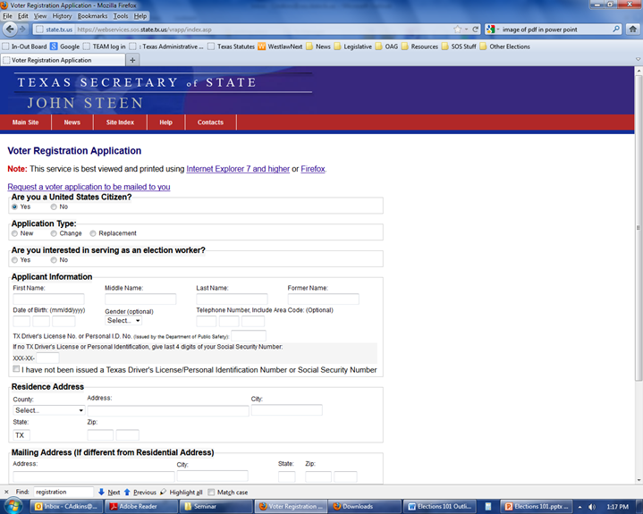
Voter Registration
Application Required for Registration (13.002)
  In writing, signed by the applicant, and
  Submitted by personal delivery, mail, or fax transmission
  If submitted by fax, a copy of the registration application must be submitted by mail and be received by the VR no later than the fourth business day after the fax is received.
www.sos.state.tx.us/elections/voter/reqvr.shtml

Slide 14
General Election Information
Uniform Election Dates
Types of Elections
Plurality v. Majority
Contacts/Joint Elections

Slide 15
Uniform Election Dates
  Uniform Election Dates –(41.001)
    Each general or special election is required to be held on one of the following dates:
      Second Saturday in May in an odd-numbered year;
      Second Saturday in May in an even numbered year (for political subdivisions other than a county); OR
      First Tuesday after the First Monday in a November.
    EXCEPTIONS:
      Runoff election
      Elections that result from a court order
      Emergency election under Section 41.0011
      Election to fill vacancy in the legislature under Section 203.013
      Election held under a statute that expressly provides that the requirement of Subsection (a) does not apply to the election,
      Initial election for the members of the governing body of a newly incorporated city.

Slide 16
Types of Elections
    General Elections
      Presidential Election,
      General Election for State and County officers,
      Regular Officer Elections for Cities, School Districts, Water Districts, Hospital Districts, Library Districts.
    Special Elections
      Special Election to fill a Vacancy,
      Constitutional Amendment Election,
      Local Option Liquor Elections,
      Tax Ratification Elections,
      Bond Elections,
      Bingo Elections,
      Stock Law Elections,
      Hail Suppression Elections, etc., etc., etc.…..

Slide 17
Plurality v. Majority
Plurality: A candidate must receive more votes than any other candidate for the office.
Majority: A candidate must receive more than 50% of the total vote.
  Runoff Election: If no candidate received the vote necessary to be elected in an election requiring a majority vote, a runoff election is required. (2.021)
Elections that Require a Majority Vote:
  Primary election (172.003)
  Special election to fill vacancy in legislature or Congress (203.003, 204.005, 204.021)
  Election for an office of a city with a population of 200,000 or more.
  City that has increased the term of its elected officials to more than two years (Article XI, Section 11)
  Otherwise provided by law – (Education, Water Code, etc.)

Slide 18
Contracts/Joint Elections
Joint Elections
  If two or more entities are holding an election on the same day in a particular territory, then they may enter into a joint election agreement and share precincts, workers, and/or equipment, etc. (Chapter 271)
Contract for Election Services
  Contract between county election officer and entity holding election for various election services including the leasing of election equipment. (31.092)

Slide 19
Pre-Election Day Procedures
Order of Election
Candidate Filing Period
Notice of Election
Ballot Drawing/Ballot Certification
Voting Systems Testing
Early Voting

Slide 20
Order of Election
Order must include:
  The date of the election;
  The offices or measures to be voted on;
  The location of the main early voting polling place;
  The early voting clerk’s official mailing address.
  Branch early voting polling places. (Recommended for counties)
  The dates and hours for early voting. (Recommended for counties)
  The dates and hours of any Saturday and Sunday early voting. (Recommended for counties)
Deadlines vary by election
Requirements outlined in Sections 3.006, 85.004, 85.007(a), 85.007, 83.010.
Forms located at:
  http://www.sos.state.tx.us/elections/forms/pol-sub/index.shtml

Slide 21
Notice of Deadline to File Application for Place on the Ballot
The notice must be posted not later than the 30th day before the first day on which a candidate may file an application. (Sec. 141.040).
NEW LAW: Senate Bill 910 (2013) amended Section 144.005 to provide a “first day to file” for other political subdivisions. An application may not be filed earlier than the 30th day before the date of the filing deadline.
Form located at: http://www.sos.state.tx.us/elections/forms/pol-sub/3-2af.pdf

Slide 22
Notice of Election
Notice must include:
  The type and date of the election;
  The location of each polling place;
  The hours the polls will be open;
  The location of the main early voting polling place;
  The regular dates and hours for early voting by personal appearance;
  The dates and hours of any Saturday or Sunday early voting, if any; and
  The early voting clerk’s mailing address
In an election ordered by the commissioners court or by an authority of a city or school district, the notice of election must be published in a newspaper in accordance with 4.003(a)(1).
  Forms located at: http://www.sos.state.tx.us/elections/forms/pol-sub/index.shtml

Slide 23

Early Voting
State Law requires EV be conducted in person and by mail.
Dates of Early Voting:
  General Rule: 17th day to 4th day before Election Day.
  Special runoff election for state senator, state representative or primary runoff: begins on the 10th day before the elections and ends on the 4th day.
  Uniform Election Date in May and resulting runoff: 12th day to 4th day before election.
  If first day falls on a Saturday, Sunday, or legal holiday, EV begins on the next regular business day. (85.001)
Early Voting by Mail
  State Application for a Ballot By Mail (ABBM) must be received between the 60th day and the 9th day before election
  Annual ABBM due to age or disability (NEW LAW: House Bill 666, 83rd Legislature)
  Federal Postcard Application (FPCA) must be received by the 7th day before the election.

Slide 24
Curbside Voting/Accessibility
Curbside Voting
  Voter physically unable to enter polling place may vote curbside.
  Election worker(s) qualify voter, bring a selection of ballots or a DRE to the voter, and allow voter to choose, mark, and cast ballot curbside.
Accessibility
  All buildings used as polling places in Texas must be accessible to voters with disabilities.
  With certain exemptions, each polling place must provide at least one accessible voting machine for use by voters with disabilities so that such voters may vote in private and without assistance.

Slide 25
Post-Election Procedures
Canvass
  Ministerial duty
  Quorum = 2 members of canvassing authority
Reports
  Precinct by Precinct Report
  Partial Manual Count Report

Slide 26
Post-Election Procedures
Qualifying for Office
    Certificate of Election (67.016)
    Statement of Elected Officer (Art XVI, Sec. 1, Tex. Const.)
    Oath of Office, Chapter 602, Texas Government Code
  Filed locally, unless district or state office.
Certificate of Election
Statement of Elected Officer
Oath of Office

Slide 27
Post-Election Procedures
Recounts (Title 13, Election Code)
  Petition for a Recount
  Automatic Recount
  http://www.sos.state.tx.us/elections/laws/recounts.shtml
Election Contests (Title 14, Election Code)
  Action occurs in district court.
  Losing candidate files suit against the winning candidate.

Slide 28
Voting Systems
Methods of Voting
  DRE Voting System
  Optical Scan Voting System
  Manually Counted Paper Ballots
Voting System Standards
State Certification Process
Adoption of a Voting System
Contract to Acquire a System
Testing Requirements

Slide 29
Websites
http://www.sos.state.tx.us/elections/
http://www.votetexas.gov/

